Slide 1
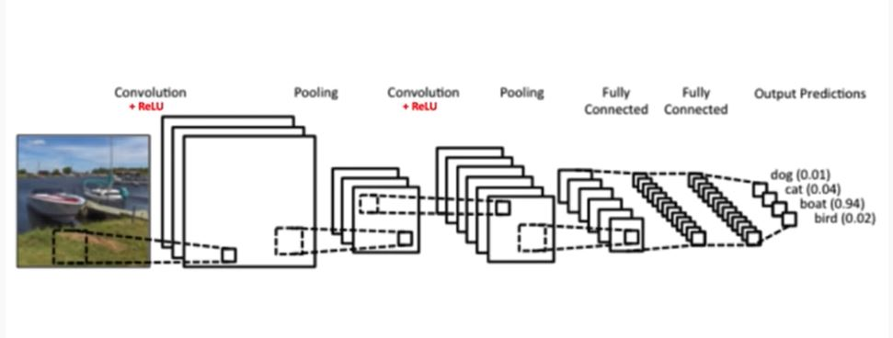
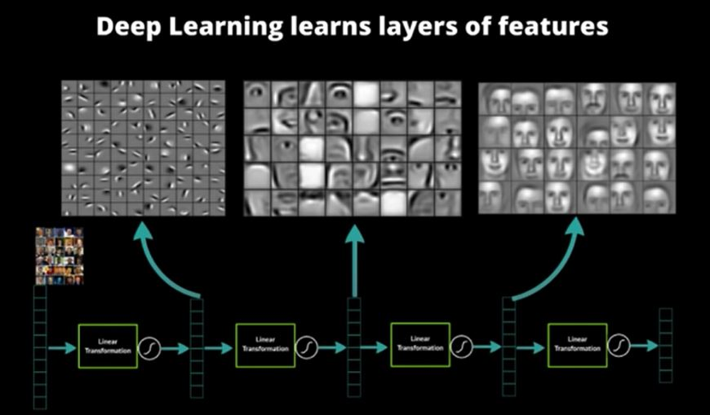

Slide 2
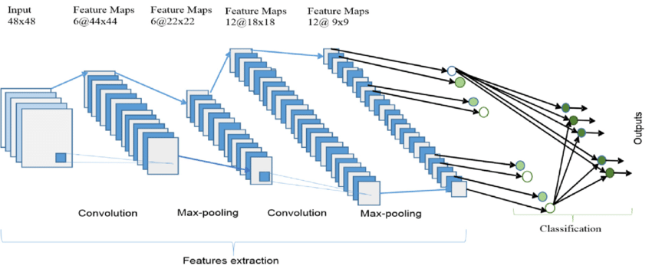
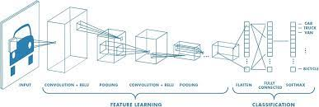

Slide 3
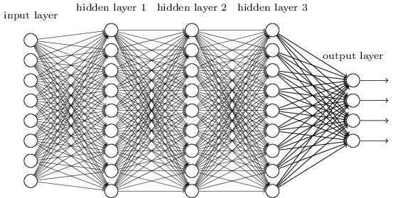
Smaller Network: CNN
We know it is good to learn a small model.
From this fully connected model, do we really need all the edges?
Can some of these be shared?

Slide 4


Consider learning an image:
Some patterns are much smaller than the whole image
Can represent a small region with fewer parameters
“beak” detector

Slide 5

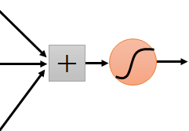
Same pattern appears in different places: They can be compressed! What about training a lot of such “small” detectors and each detector must “move around”.
“upper-left beak” detector
They can be compressed
to the same parameters.
“middle beak” detector

Slide 6
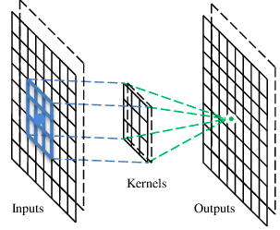
A convolutional layer
A CNN is a neural network with some convolutional layers
(and some other layers). A convolutional layer has a number
of filters that does convolutional operation.
Beak detector
A filter

Slide 7
Convolution
These are the network parameters to be learned.
1 | -1 | -1
-1 | 1 | -1
-1 | -1 | 1
1 | 0 | 0 | 0 | 0 | 1
0 | 1 | 0 | 0 | 1 | 0
0 | 0 | 1 | 1 | 0 | 0
1 | 0 | 0 | 0 | 1 | 0
0 | 1 | 0 | 0 | 1 | 0
0 | 0 | 1 | 0 | 1 | 0
Filter 1
-1 | 1 | -1
-1 | 1 | -1
-1 | 1 | -1
Filter 2
……
6 x 6 image
Each filter detects a small pattern (3 x 3).

Slide 8
Convolution
1 | -1 | -1
-1 | 1 | -1
-1 | -1 | 1
Filter 1
stride=1
1 | 0 | 0 | 0 | 0 | 1
0 | 1 | 0 | 0 | 1 | 0
0 | 0 | 1 | 1 | 0 | 0
1 | 0 | 0 | 0 | 1 | 0
0 | 1 | 0 | 0 | 1 | 0
0 | 0 | 1 | 0 | 1 | 0
Dot
product
3
-1
6 x 6 image

Slide 9
Convolution
1 | -1 | -1
-1 | 1 | -1
-1 | -1 | 1
Filter 1
If stride=2
1 | 0 | 0 | 0 | 0 | 1
0 | 1 | 0 | 0 | 1 | 0
0 | 0 | 1 | 1 | 0 | 0
1 | 0 | 0 | 0 | 1 | 0
0 | 1 | 0 | 0 | 1 | 0
0 | 0 | 1 | 0 | 1 | 0
3
-3
6 x 6 image

Slide 10
Convolution
1 | -1 | -1
-1 | 1 | -1
-1 | -1 | 1
Filter 1
stride=1
1 | 0 | 0 | 0 | 0 | 1
0 | 1 | 0 | 0 | 1 | 0
0 | 0 | 1 | 1 | 0 | 0
1 | 0 | 0 | 0 | 1 | 0
0 | 1 | 0 | 0 | 1 | 0
0 | 0 | 1 | 0 | 1 | 0
3
-1
-3
-1
-3
1
0
-3
-3
-3
0
1
3
-2
-2
-1
6 x 6 image

Slide 11
Convolution
-1 | 1 | -1
-1 | 1 | -1
-1 | 1 | -1
Filter 2
stride=1
Repeat this for each filter
1 | 0 | 0 | 0 | 0 | 1
0 | 1 | 0 | 0 | 1 | 0
0 | 0 | 1 | 1 | 0 | 0
1 | 0 | 0 | 0 | 1 | 0
0 | 1 | 0 | 0 | 1 | 0
0 | 0 | 1 | 0 | 1 | 0
3
-1
-3
-1
-1
-1
-1
-1
-3
1
0
-3
-1
-1
-2
1
Feature
Map
-3
-3
0
1
-1
-1
-2
1
3
-2
-2
-1
6 x 6 image
-1
0
-4
3
Two 4 x 4 images
Forming 2 x 4 x 4 matrix

Slide 12
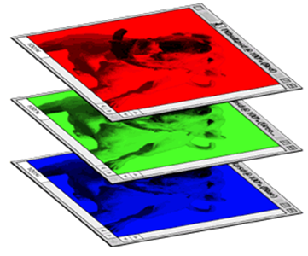
Color image: RGB 3 channels
1 | -1 | -1
-1 | 1 | -1
-1 | -1 | 1
-1 | 1 | -1
-1 | 1 | -1
-1 | 1 | -1
1 | -1 | -1
-1 | 1 | -1
-1 | -1 | 1
-1 | 1 | -1
-1 | 1 | -1
-1 | 1 | -1
1 | -1 | -1
-1 | 1 | -1
-1 | -1 | 1
-1 | 1 | -1
-1 | 1 | -1
-1 | 1 | -1
Filter 1
Filter 2
Color image
1 | 0 | 0 | 0 | 0 | 1
0 | 1 | 0 | 0 | 1 | 0
0 | 0 | 1 | 1 | 0 | 0
1 | 0 | 0 | 0 | 1 | 0
0 | 1 | 0 | 0 | 1 | 0
0 | 0 | 1 | 0 | 1 | 0
1 | 0 | 0 | 0 | 0 | 1
0 | 1 | 0 | 0 | 1 | 0
0 | 0 | 1 | 1 | 0 | 0
1 | 0 | 0 | 0 | 1 | 0
0 | 1 | 0 | 0 | 1 | 0
0 | 0 | 1 | 0 | 1 | 0
1 | 0 | 0 | 0 | 0 | 1
0 | 1 | 0 | 0 | 1 | 0
0 | 0 | 1 | 1 | 0 | 0
1 | 0 | 0 | 0 | 1 | 0
0 | 1 | 0 | 0 | 1 | 0
0 | 0 | 1 | 0 | 1 | 0

Slide 13
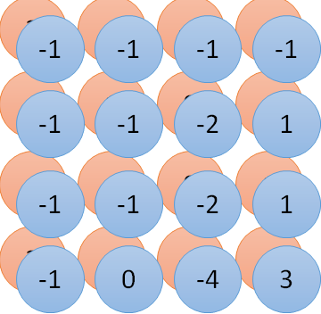
Convolution v.s. Fully Connected
1 | 0 | 0 | 0 | 0 | 1
0 | 1 | 0 | 0 | 1 | 0
0 | 0 | 1 | 1 | 0 | 0
1 | 0 | 0 | 0 | 1 | 0
0 | 1 | 0 | 0 | 1 | 0
0 | 0 | 1 | 0 | 1 | 0
1 | -1 | -1
-1 | 1 | -1
-1 | -1 | 1
-1 | 1 | -1
-1 | 1 | -1
-1 | 1 | -1
convolution
image
1 | 0 | 0 | 0 | 0 | 1
0 | 1 | 0 | 0 | 1 | 0
0 | 0 | 1 | 1 | 0 | 0
1 | 0 | 0 | 0 | 1 | 0
0 | 1 | 0 | 0 | 1 | 0
0 | 0 | 1 | 0 | 1 | 0
Fully-connected
……
……

Slide 14
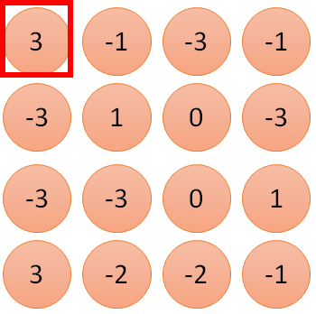
1 | -1 | -1
-1 | 1 | -1
-1 | -1 | 1
1
1
Filter 1
2
0
3
0
3
4:
0
1 | 0 | 0 | 0 | 0 | 1
0 | 1 | 0 | 0 | 1 | 0
0 | 0 | 1 | 1 | 0 | 0
1 | 0 | 0 | 0 | 1 | 0
0 | 1 | 0 | 0 | 1 | 0
0 | 0 | 1 | 0 | 1 | 0
…
0
8
1
9
0
10:
0
…
13
0
6 x 6 image
14
0
fewer parameters!
15
Only connect to 9 inputs, not fully connected
1
16
1
…

Slide 15
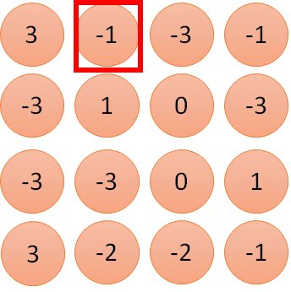
1 | -1 | -1
-1 | 1 | -1
-1 | -1 | 1
1:
1
Filter 1
2:
0
3:
0
3
4:
0
1 | 0 | 0 | 0 | 0 | 1
0 | 1 | 0 | 0 | 1 | 0
0 | 0 | 1 | 1 | 0 | 0
1 | 0 | 0 | 0 | 1 | 0
0 | 1 | 0 | 0 | 1 | 0
0 | 0 | 1 | 0 | 1 | 0
…
7:
0
8:
1
-1
9:
0
10:
0
…
13:
0
6 x 6 image
14:
0
Fewer parameters
15:
1
16:
1
Shared weights
Even fewer parameters
…

Slide 16


The whole CNN
cat dog ……
Convolution
Max Pooling
Can repeat many times
Fully Connected Feedforward network
Convolution
Max Pooling
Flattened

Slide 17
Max Pooling
1 | -1 | -1
-1 | 1 | -1
-1 | -1 | 1
-1 | 1 | -1
-1 | 1 | -1
-1 | 1 | -1
Filter 1
Filter 2
3
-1
-3
-1
-1
-1
-1
-1
-3
1
0
-3
-1
-1
-2
1
-3
-3
0
1
-1
-1
-2
1
3
-2
-2
-1
-1
0
-4
3

Slide 18
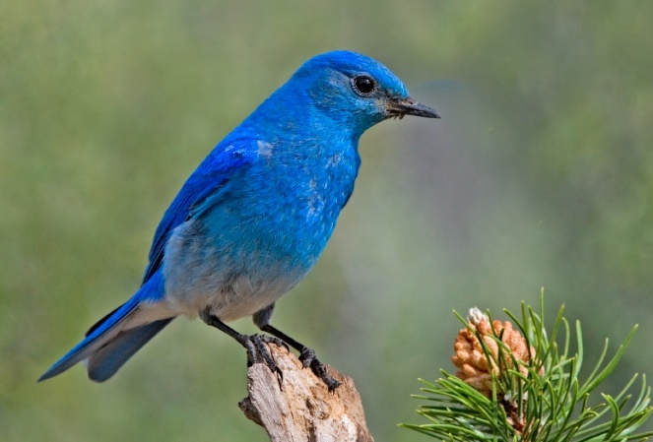
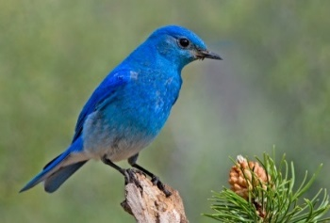
Why Pooling
Subsampling pixels will not change the object
bird
bird
Subsampling
We can subsample the pixels to make image smaller
fewer parameters to characterize the image

Slide 19
A CNN compresses a fully connected network in two ways:
Reducing number of connections
Shared weights on the edges
Max pooling further reduces the complexity

Slide 20
Max Pooling
New image
but smaller
1 | 0 | 0 | 0 | 0 | 1
0 | 1 | 0 | 0 | 1 | 0
0 | 0 | 1 | 1 | 0 | 0
1 | 0 | 0 | 0 | 1 | 0
0 | 1 | 0 | 0 | 1 | 0
0 | 0 | 1 | 0 | 1 | 0
Conv
3
0
-1
1
Max
Pooling
3
1
0
3
2 x 2 image
6 x 6 image
Each filter
is a channel

Slide 21
The whole CNN
3
0
-1
1
Convolution
3
1
0
3
Max Pooling
Can repeat many times
A new image
Convolution
Smaller than the original image
The number of channels is the number of filters
Max Pooling

Slide 22
The whole CNN
cat dog ……
Convolution
Max Pooling
Fully Connected Feedforward network
A new image
Convolution
Max Pooling
Flattened
A new image

Slide 23
Flattening
3
0
1
3
0
-1
1
3
3
1
-1
0
3
Flattened
1
Fully Connected Feedforward network
0
3

Slide 24
CNN in Keras

Slide 25
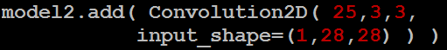
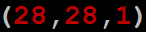
CNN in Keras
Only modified the network structure and input format (vector -> 3-D tensor)
input
Convolution
1 | -1 | -1
-1 | 1 | -1
-1 | -1 | 1
-1 | 1 | -1
-1 | 1 | -1
-1 | 1 | -1
There are 25 3x3 filters.
……
Max Pooling
Input_shape = ( 28 , 28 , 1)
28 x 28 pixels
1: black/white, 3: RGB
Convolution
3
-1
3
Max Pooling
-3
1

Slide 26
CNN in Keras
Only modified the network structure and input format (vector -> 3-D array)
Input
1 x 28 x 28
Convolution
How many parameters for each filter?
9
25 x 26 x 26
Max Pooling
25 x 13 x 13
Convolution
How many parameters
for each filter?
225=
25x9
50 x 11 x 11
Max Pooling
50 x 5 x 5

Slide 27
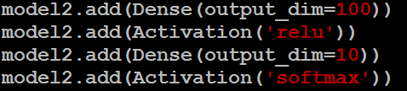
CNN in Keras
Only modified the network structure and input format (vector -> 3-D array)
Input
1 x 28 x 28
Output
Convolution
25 x 26 x 26
Fully connected feedforward network
Max Pooling
25 x 13 x 13
Convolution
50 x 11 x 11
Max Pooling
1250
50 x 5 x 5
Flattened

Slide 28
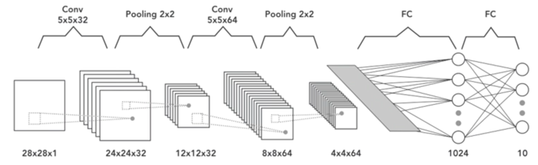
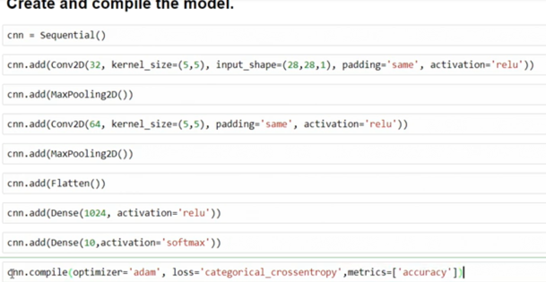
The input is a 28 by 28 grayscale image. Because this is a grayscale image,
the number of channels will be one (Colored image: RGB, or red, green, and blue
two convolution layers
kernel size of five.
The first convolution has 32 output feature maps,
and the second one has 64 output feature maps.
A fully connected layer passes the output to a second fully connected layer
which acts as the final soft max output layer.
ten outputs in the final layer

Slide 29
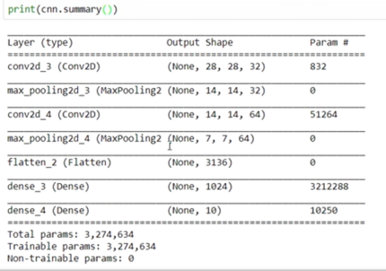

Slide 30
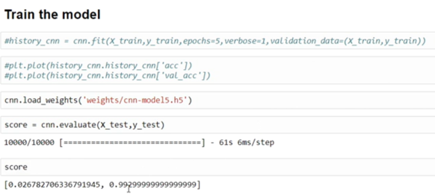

Slide 31
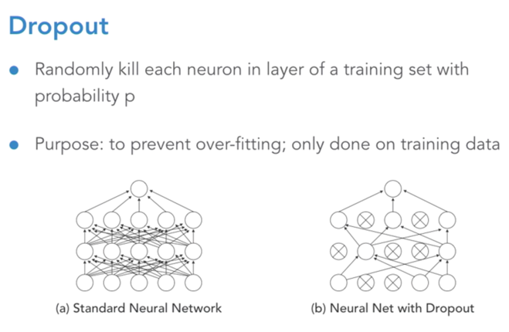
Enhancement to CNN:
The effect of this random Dropout forces the network to learn a redundant representation of the data.

Slide 32
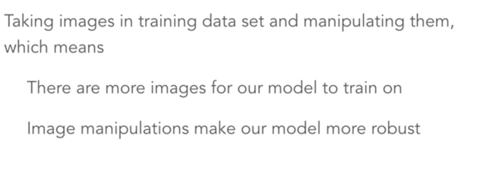
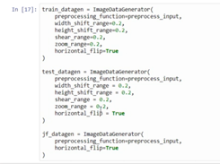
Enhancement to CNN: Image Augmentation

Slide 33



Keras
Keras provides data sets loading function:
http://keras.io/datasets/
Very flexible
or
Need some effort to learn
Easy to learn and use
Interface of TensorFlow or Theano
(still have some flexibility)
keras
You can modify it if you can write TensorFlow or Theano
Notes:
適合初學者
台大上課
太過 ＯＰ
Toolkit

Slide 34
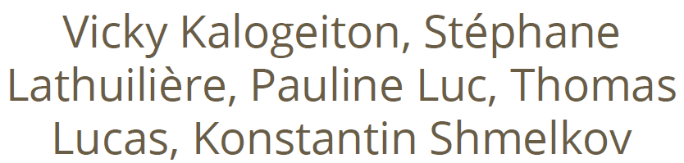
Keras: strengths
● Easy-to-use Python library
● It wraps Theano and TensorFlow (it benefits from the advantages of both)
● Guiding principles: modularity, minimalism, extensibility, and Python-nativeness
● Why python? Easy to learn, powerful libraries (scikit-learn, matplotlib...)
● Many easy-to-use tools: real-time data augmentation, callbacks (Tensorboard visualization)
● Keras is gaining official Google support

Slide 35
Keras: Weakness
● Less flexible
● No RBM for example
● Less projects available online than caffe
● Multi-GPU not 100% working

Slide 36
Install Tensorflow
https://www.tensorflow.org/install/
Mac: open Terminal window
$ pip install tensorflow
Windows: open Anaconda Prompt window
$ pip install tensorflow

Slide 37
Install Keras
Mac: open command window
$ pip install keras
Windows: open Anaconda Prompt window
$ pip install keras
Then in Rodeo, use the code:
import keras
print (keras.__version__)

Slide 38
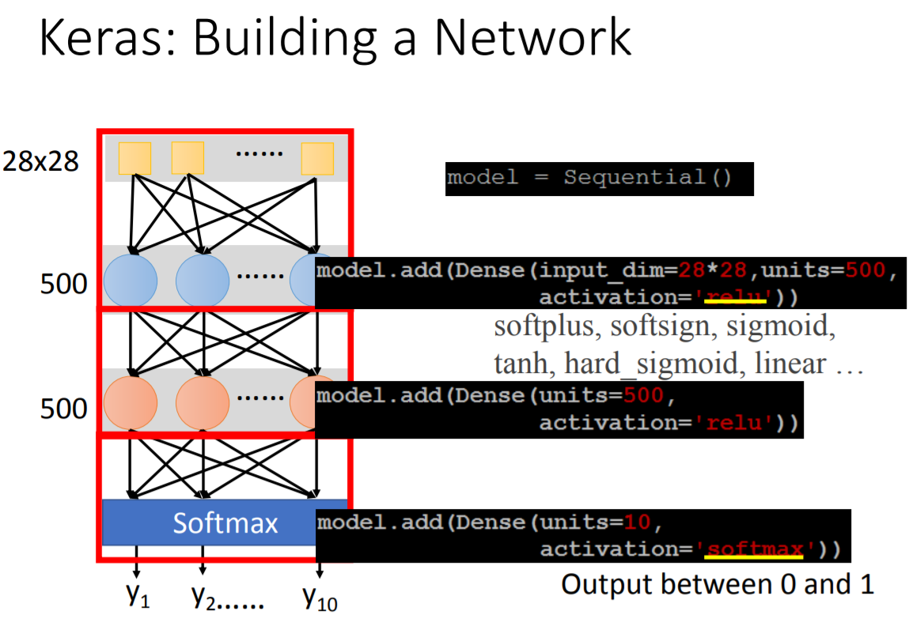

Slide 39
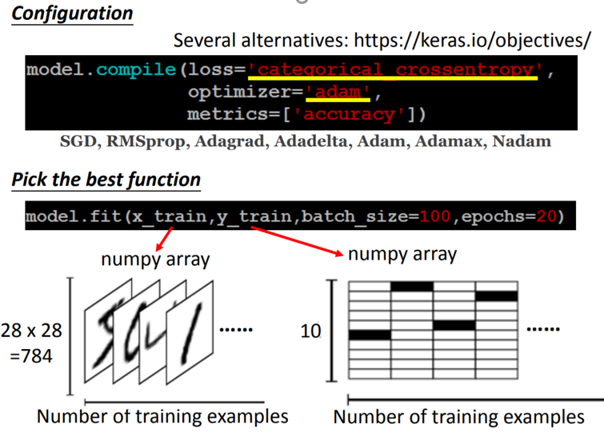

Slide 40
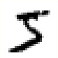
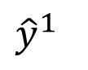
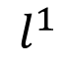
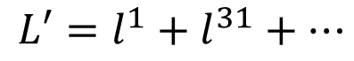
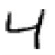
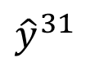
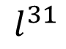
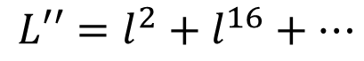
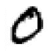
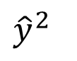
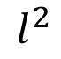
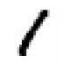
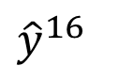
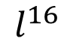
Mini-batch
We do not really minimize total loss!
Randomly initialize network parameters
x¹
NN
y¹
Pick the 1st batch
Mini-batch
NN
x³¹
y³¹
Update parameters once
……
Pick the 2nd batch
Update parameters once
x²
NN
y²
…
Until all mini-batches have been picked
Mini-batch
x¹⁶
NN
y¹⁶
……
one epoch
Repeat the above process
Notes:
Each time we update parameters, we have different target -> 不安
Shuffle data, and repeat above process

Slide 41
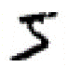
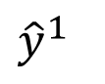
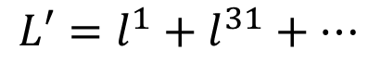
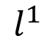
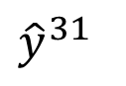
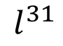
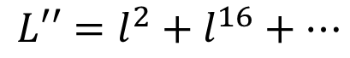
Mini-batch
Batch size influences both speed and performance. You have to tune it.
Pick the 1st batch
x¹
NN
y¹
Mini-batch
NN
Update parameters once
x³¹
y³¹
……
Pick the 2nd batch
100 examples in a mini-batch
Update parameters once
Batch size = 1
…
Until all mini-batches have been picked
Stochastic gradient descent
Repeat 20 times
one epoch
Notes:
Let’s try it.
If Batch size=1, then it is SGD.

Slide 42

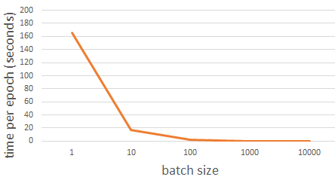
Speed
Very large batch size can yield worse performance
Smaller batch size means more updates in one epoch
E.g. 50000 examples
batch size = 1, 50000 updates in one epoch
batch size = 10, 5000 updates in one epoch
166s
1 epoch
17s
10 epoch
166s
Batch size = 1 and 10, update the same amount of times in the same period.
Batch size = 10 is more stable, converge faster
17s
GTX 980 on MNIST with 50000 training examples
Notes:
GPU has limitation. So batch size can’t be too large

Slide 43
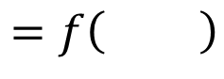
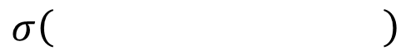
Review: Speed - Matrix Operation
……
y₁
W¹
W²
W^{L}
……
y₂
b¹
b²
b^{L}
……
……
……
……
……
x
a¹
a²
y
……
y_{M}
y
x
Forward pass
(Backward pass is similar)
W^{L}
…
W²
W¹
x
b¹
b²
…
b^{L}
+
+
+
Notes:
Draw it?
GPU computation.

Slide 44











Speed - Matrix Operation
Why mini-batch is faster than stochastic gradient descent?
Stochastic Gradient Descent
=
=
……
Mini-batch
matrix
Practically, which one is faster?
=
Notes:
SGD (batch size=1)

Slide 45




Keras
Save and load models
http://keras.io/getting-started/faq/#how-can-i-save-a-keras-model
How to use the neural network (testing):
case 1:
case 2:
Notes:
Scalar test loss (if the model has a single output and no metrics) or list of scalars (if the model has multiple outputs and/or metrics). The attributemodel.metrics_names will give you the display labels for the scalar outputs.

Slide 46

Example 1
Test loss 0.14084320782721044 Test accuray 0.9575

Slide 47

Example 2
Test loss 2.306609627532959 Test accuray 0.1028

Slide 48
Definition
A neural network with just one layer
A loss function (Mean Squared Error (MSE))
One neuron, numerous weights w₁, w₂, w₃…, a bias b
A ReLU activation
Knowing our network and our loss function, how can we tweak the weights and biases to minimize the loss?
48

Slide 49

Minimize the loss Using gradient Descent

Slide 50

1- What is the Loss (cost) Function …(MSE)
MSE squares the difference between every network output (o) and true label (y), and takes the average
50

Slide 51

2- What is the activation function used?
A ReLU is simply a function that converts any negative values to 0. Let’s rename that as the max(0,z) function, which returns z if z is positive and 0 if z is negative.
activation(x) = max(0, w ∙ x + b)
activation(z) = max(0, z)
51

Slide 52

➔The loss function
Capital X (is a vector of input)
What is the slope of the loss function?
52

Slide 53


Slope is the derivative of the loss function
With respect to weights w₁, w₂, w₃…, and bias b
Partial derivative example for f(x,y) = 3x²y.
53

Slide 54

The gradient of the function f(x,y) = 3x²y
is a horizontal vector, composed of the two partials:
the gradient of the function in the x-direction,
the gradient of the function in the y-direction,
54

Slide 55

How can we compute the partial derivatives of vector equations?

Slide 56

The gradient of the function g(x,y) = 2x+y⁸
is a horizontal vector, composed of the two partials:
the gradient of the function in the x-direction,
the gradient of the function in the y-direction,
56

Slide 57

Gradient of a Vector Function :Jacobian Matrix
A neural network with just one layer
A loss function (Mean Squared Error (MSE))
One neuron, nuerous weights w₁, w₂, w₃…, a bias b
A ReLU activation
57

Slide 58




Gradient of the identity function f(x) =x
58

Slide 59



Gradient of vector sum
since the partial derivative of a function with respect to a variable that’s not in the function is zero, it can be further simplified as:
59

Slide 60



Vector chain rule
Since, each function f matches with
exactly 1 function g

Slide 61

What is the Gradient of A Neuron?

Slide 62

let f(x)=w∙x+b, and g(x)=max(0,x)then
neuron(x)=g(f(x)). (Apply activation function)
➔ use the vector chain rule to find the derivative of this composition of functions
z=f(x)=w∙x+b

Slide 63




What is the partial derivative of z with respect to w? (v=w .x and u=sum(v) 1- derivative of wx 2- derivative of b
63

Slide 64
What is the partial derivative of z with respect to w? (v=w .x and u=sum(v) 1- derivative of wx 2- derivative of b
64

Slide 65
What is the partial derivative of z with respect to w? (v=w .x and u=sum(v) 1- derivative of wx 2- derivative of b
65

Slide 66


What is the partial derivative of z z= u+b
66

Slide 67



What is the partial derivative of neuron(z) with respect to z?
Neuron(z)=max(0,z)=max(0, sum(w⊗x)+b).
67

Slide 68

What is the partial derivative of neuron(z) with respect to b?

Slide 69


Gradient of Loss Function

Slide 70




Gradient With Respect to Weights

Slide 71





Slide 72


This is the derivative of the loss function

Slide 73

What does it mean ?
ei= w∙x+b-y can be interpreted as an error term
The derivative represents the slope (how much we must move our weights by in order to minimize our error)
If our neural network has just begun training, and has a very low accuracy, the error will be high and thus the derivative will be large as well. Therefore, we will have to take a big step in order to minimize our error.

Slide 74

Subtract current weights with the derivative in order to get one step closer to minimizing the loss function
η represents the learning rate➔The larger the learning rate, the bigger the step

Slide 75





Gradient With Respect to bias

